Slide 1
Recognizing Verbs

Slide 2
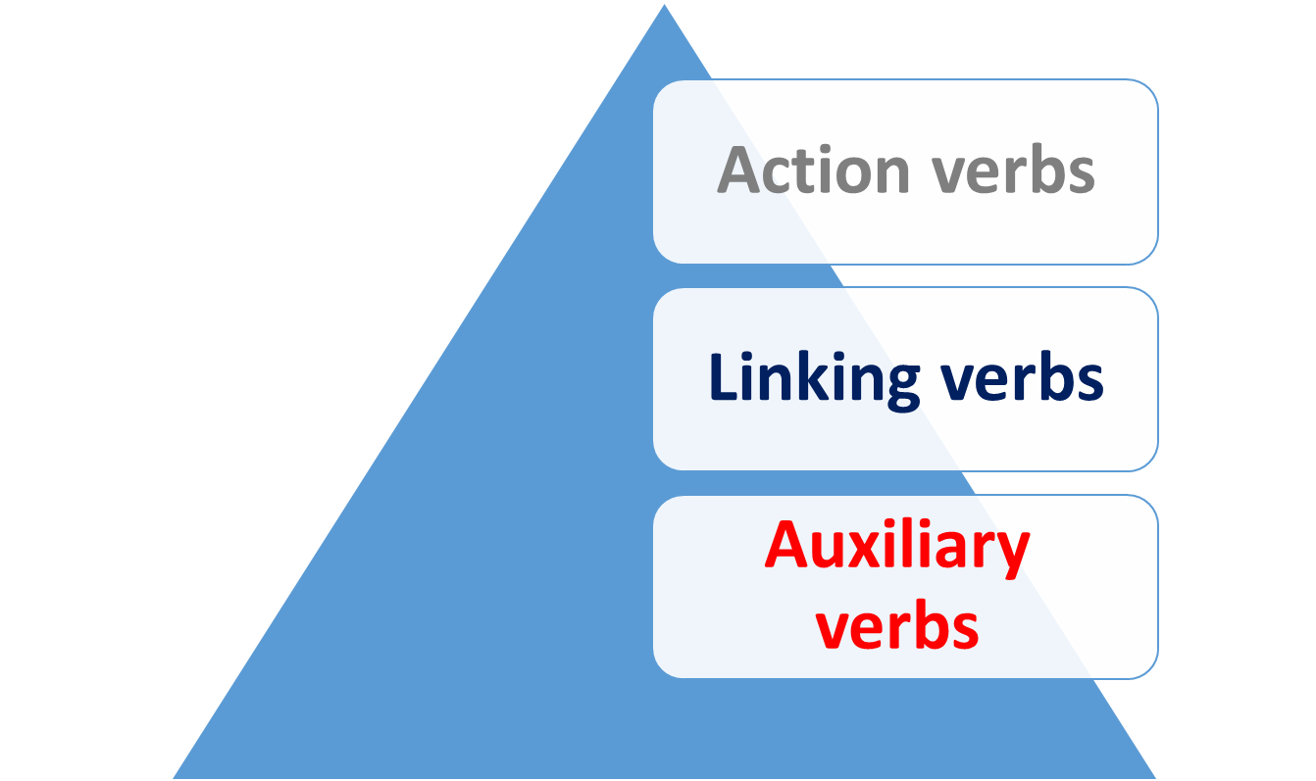
Recognizing Verbs

Slide 3

Recognizing Verbs
Verbs are the most important words in sentences.
When you can recognize them ,you are on your
way.
Everything else in a sentence relates to the verb
either directly or indirectly. The easiest verbs to
recognize are those which show action.

Slide 4
Recognizing Verbs
ACTION VERBS

Slide 5


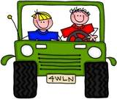
Action Verbs
An action verb is a verb which contains action in the sentence.
run, jump, play, sing, drive
What are these words doing? They are expressing action, something that a person, animal, or thing can do. As a result, we call these words action verbs.
Look at the examples below:

Slide 6




Action Verbs
Action verbs may be used alone as
the main verb of a sentence.
Sarah ran as fast as she could to the store.
Bill and Jim carried the heaviest load of bricks.

Slide 7
Action Verbs
Action verbs can be time-telling verbs.
They tell when something takes place – in
the present, in the future or in the past.
Examples:
My dog runs faster than yours.
(present tense)
Yesterday he ran around the block.
(past tense)
Tomorrow he will run in a race.
(future tense)

Slide 8

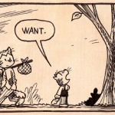
Action Verbs
Not all action verbs show physical action.
Many verbs in English express mental action
They can be actions you can't see.
They just express a different kind of action.
Examples:
Tom thought about pets.
He wanted a puppy.

Slide 9
Main Verbs can be further divide into:
i) Transitive
ii) Intransitive

Slide 10


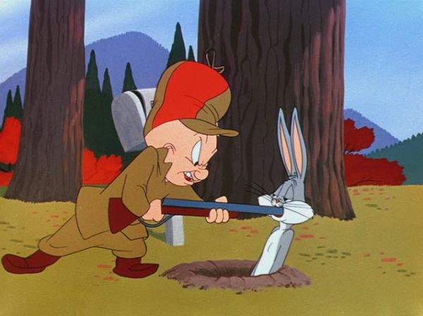
Transitive Verb
A transitive verb conveys an action and is followed by an
Object that receives the action of the verb.
Examples:
I cleaned the windows yesterday.
transitive verb object
I took my baby to the clinic.
transitive verb object
We hunt rabbits.
transitive verb object

Slide 11

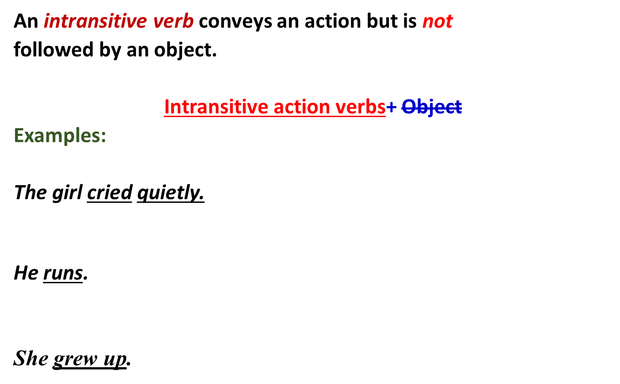

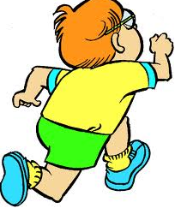


Slide 12
LINKING VERBS

Slide 13
Linking verbs
Some verbs do not show action. Instead they link the subject to another word, phrase, or clause that names or describes it. Thus they are known as linking verbs.
The various forms of the verb be is very irregular and takes many forms such as:
is, was, are, am, were, being, been.

Slide 14
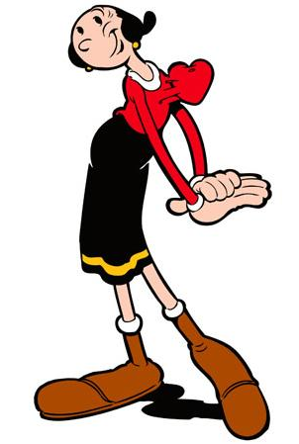
Linking verbs
Example:
Jane is tall.
is is a linking verb.
The word is does not show action. Instead, is establishes
a connection, or equivalency, between Jane and tall. It
links the woman to an attribute describing her, and so it
is known as a linking verb.

Slide 15

Linking verbs
Though forms of be are the most
common linking verbs, they are not
the only ones.
Many verbs that refer to the senses
are linking verbs.
feel, taste, sound, smell, look, become, seem, appear, seem, keep, resemble

Slide 16
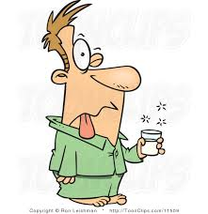
Linking verbs
Example:
This drink tastes good.
tastes is the linking verb which connects
the subject (drink) to the adjective which
describes it (good).
A linking verb may connect the subject
with a noun (cat, dog etc.), a pronoun
(his, him etc.) or an adjective.

Slide 17
AUXILIARY VERBS

Slide 18

Auxiliary verbs
An auxiliary (also called helping verb, helper verb, auxiliary verb, or verbal auxiliary, abbreviated AUX) is a verb functioning to give further semantic or syntactic information about the main or full verb following it.
The man will complete the project.
You must complete the assignment.
I do know the answer to that question.

Slide 19
List of Helping Verbs
The following table details a list of helping verbs:
List of Helping Verbs
am | is | are
was | were | be
being | been | have
has | had | do
does | did | can
could | may | might
must | will | should
would | ought to | used to

Slide 20
Auxiliary verbs (To Be)
Be, Do and Have are auxiliary verbs, they are irregular verbs
and can be used as main verbs.
To be
Be is the most common verb in the English language.
It can be used as an auxiliary and a main verb. It is
used a lot in its other forms.
Base form= be
Present form= am/is/are
Past form= was/were
Present Participle/Gerund= being
Past Participle= been

Slide 21
To Do
To do
The verb do is one of the most common verbs in English. It can be used as an auxiliary and a main verb. It is often used in questions.
Base form = do
Present form = do/does
Past form = did
Present Participle / Gerund = doing
Past Participle = done

Slide 22
To have
To have
Have is one of the most common verbs in the English
language.
Base form = have
Present form = have / has
Past form = had
Present Participle / Gerund = having
Past Participle = had

Slide 23
Modal verbs
All the auxiliary verbs except be, do and have are called modals.
Unlike other auxiliary verbs modals only exist in their helping form; they cannot act alone as the main verb in a sentence.
The modal verbs are:-
CAN/ COULD / MAY / MIGHT / MUST / SHALL / SHOULD / OUGHT TO(Probably) / WILL / WOULD

Slide 24
Modal verbs
Notes:
1.They do not use inflectional endings
(-s, -ed, -ing, -en)
Can Cans
2. They can not function as main verbs.
I may them. I might it. I must us.

Slide 25
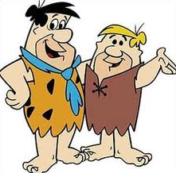

Modal verbs
People should choose friends wisely.
modal auxiliary main verb
Ann may write an assay on that topic.
modal auxiliary main verb

Slide 26
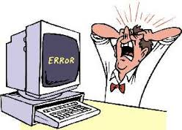
Modal verbs
3.When a verb phrase uses more than one auxiliary verb, the
modal auxiliary always precedes the be, have, or do auxiliary.
The computer could have made an error.
modal auxiliary auxiliary main verb

Slide 27
Modal verbs
4. They are followed by the base form only (“base form” = infinitive minus “to”
Examples:
I will go. I shall go. I can go.
I would go. I should go. I could go.
I may go. I might go. I must go.

Slide 28
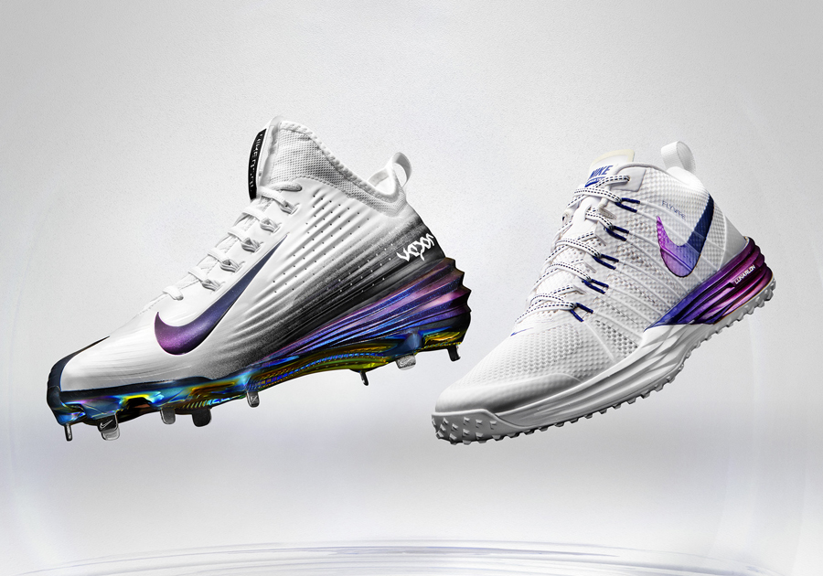
Auxiliary verb vs linking verb
To distinguish between an auxiliary verb and a
linking verb, simply look to see whether an action
verb immediately follows the “to be” verb.
For example, in the sentence
John was wearing his lucky sneakers at the baseball game.
the action verb wearing immediately follows the “to be” verb was, So we know that the “to be” verb in this case is an auxiliary verb because it is “helping” out the action verb wearing.

Slide 29
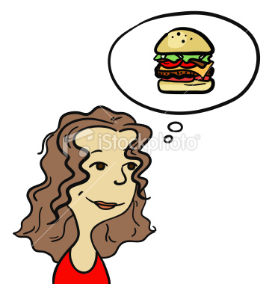
Auxiliary verb vs linking verb
However, in the sentence
I was hugry.
the to be verb was appears alone, so it cannot be
classified as an auxiliary verb. In this case it is a
linking verb that describes how I was feeling.

Slide 30
Exercise
Is this sentence correct?
We be will seeing you.
modal auxiliary be auxiliary main verb
NO
The correct answer is:
We will be seeing you.
modal auxiliary be auxiliary main verb

Slide 31
Exercise
Q: Underline the verb(s) in each sentence and indicate whether it is an action verb, a linking verb, or an auxiliary verb by writing the appropriate answer next to the sentence.
We ate lunch around 2 p.m. yesterday.
2. I may apply for a job at Best Buy in Victoria Mall.
3. I am anxious to finish the research project.

Slide 32
Exercise
Answer Key: Exercise 1
We ate lunch around 2 p.m. yesterday. (Action verb)
2. I may apply for a job at Best Buy in Victoria Mall.
(Modal verb; Action verb)
3. I am anxious to finish the research project. (Linking verb)

Slide 33
Exercise
Q. Which of the following sentences have transitive verb and which have Intransitive verbs :
1. I did my work.
2. He has cooked.
3.We are playing tennis.
4. She writes well.

Slide 34
Exercise
Q. State whether the underlined verb is auxiliary or main verb.
I can't understand what he says.
My brother is playing with a ball.
The trader has many horses.
I may visit Australia soon.
The dog is a faithful animal.
We play games every evening .
.

Slide 35
Exercise
Q. Is the verb in this sentence linking, transitive or intransitive?)
Bill seems very nice.
Q. Is the verb in this sentence linking, transitive or intransitive?)
Molly is looking at the picture now.

